Slide 1


Movie Recommendation System using Collaborative Filtering and Content-based Filtering
Team: 34
Presentation by:
Abhishek Nayak (an897)
Pranathi Vaddela (pv250)
Aditya Kaushik Jonnavittula (aj918)

Slide 2
Contents
Movie Recommendation System
Dataset used
Data Exploration
Collaborative Filtering
Content-based Filtering
Future Work

Slide 3

Movie Recommendation System
There are two main elements in every recommendation system: users and items.
The system generates movie predictions for its users, while items are the movies themselves.
The primary goal is to filter and predict only those movies that a corresponding user is most likely to want to watch.

Slide 4
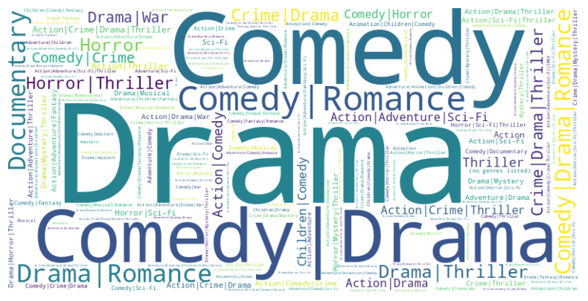
Dataset Used
The dataset describes 5-star rating and free-text tagging activity from MovieLens, a movie recommendation service.
It contains 100836 ratings and 3683 tag applications across 9742 movies.
Users were selected at random for inclusion. All selected users had rated at least 20 movies.
The dataset has the following files:
Movies.csv
Ratings.csv
Tags.csv
links.csv

Slide 5
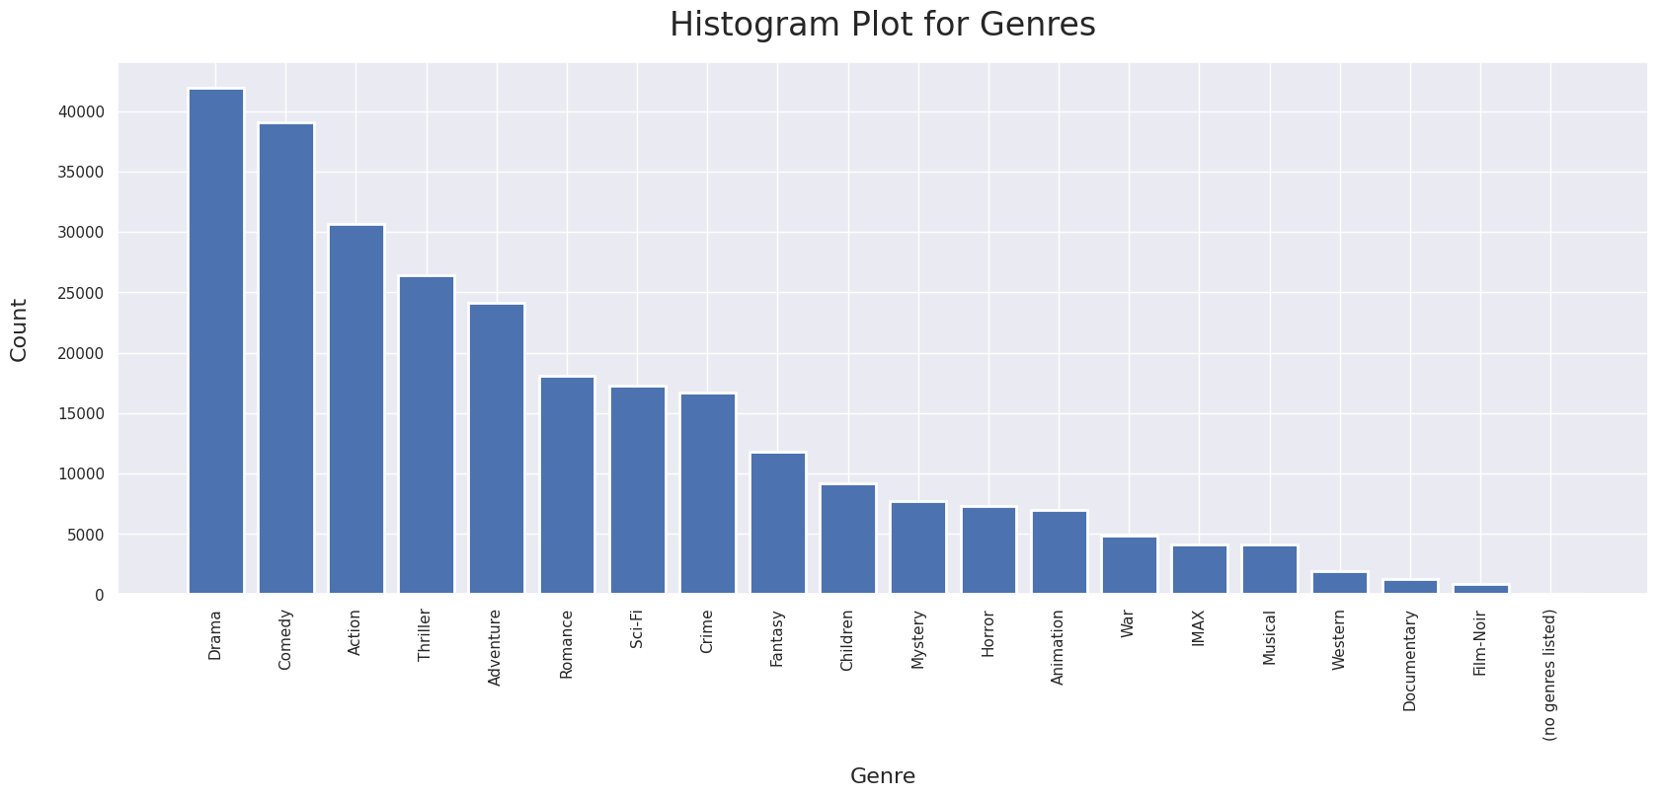
Data Exploration

Slide 6
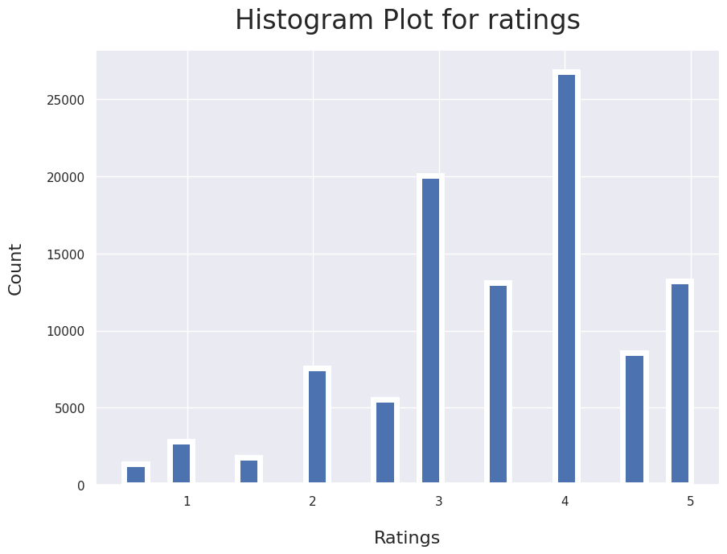
Data Exploration

Slide 7
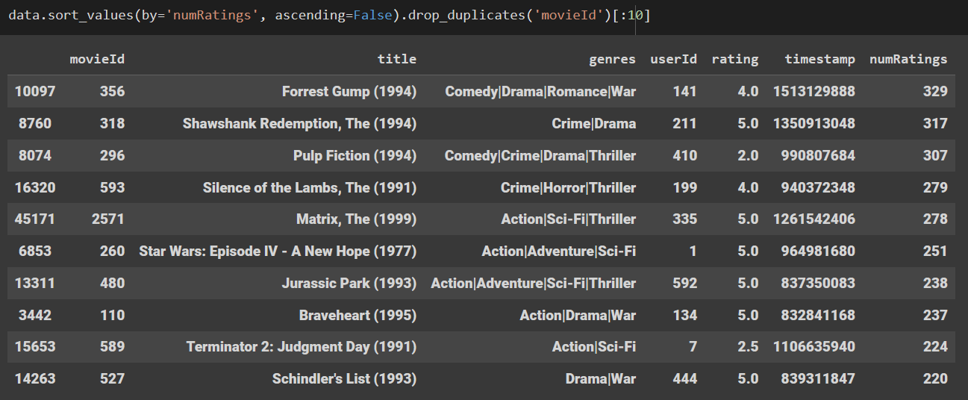
Data Exploration

Slide 8
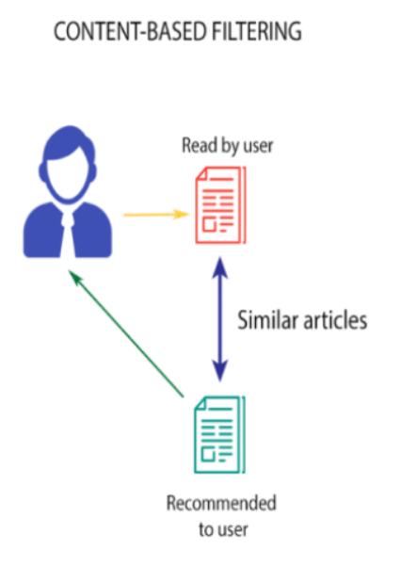
Content-based Filtering
Content-based filtering is a technique used to suggest items to users based on the similarity of their attributes to items that the user has interacted with or shown interest in.
It works by analyzing the features or characteristics of items and comparing them to a user's historical interactions with other items for personalised recommendations.
In the case of movie recommendations, content-based filtering would analyze the content or metadata of movies such as genres, actors, directors, and plot summaries to recommend movies with similar features to those a user has previously enjoyed.

Slide 9
Content-based filtering methods
Item centered Approach
If we use user features, the approach is item-centered. We build a model for each item based on user features to predict the probability of each user liking the item or the rating they would give it. This method is robust but less personalized.
“what is the probability for each user to like this item?” (or “what is the rate given by each user to this item?”, for regression)
User-centered Approach
If we use item features, the approach is user-centered. We build a model for each user based on item features to predict the probability of the user liking each item or the rating they would give it. This method is more personalized but less robust as users have interacted with fewer items.
“what is the probability for this user to like each item?” (or “what is the rate given by this user to each item?”, for regression)

Slide 10
Advantages of Content-based filtering
No data from other users is required to start making recommendations
Recommendations are highly relevant to the user
Recommendations are transparent to the user
We can avoid the “cold start” problem
Content-based filtering systems are generally easier to create

Slide 11
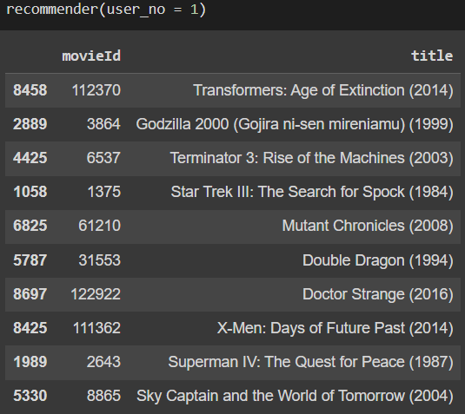
Results
Recommends top 10 movies to user-1 according to his preferences
RMSE of content-based recommendations - 0.67

Slide 12
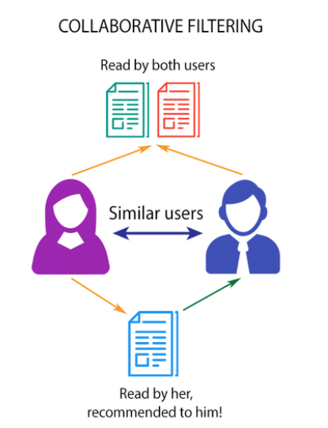
Collaborative Filtering
Collaborative filtering filters information by using the interactions and data collected by the system from other users. It’s based on the idea that people who agreed in their evaluation of certain items are likely to agree again in the future
Most collaborative filtering systems apply the so-called similarity index-based technique. In the neighborhood-based approach, a number of users are selected based on their similarity to the active user. Inference for the active user is made by calculating a weighted average of the ratings of the selected users.
Collaborative-filtering systems focus on the relationship between users and items. The similarity of items is determined by the similarity of the ratings of those items by the users who have rated both items.

Slide 13

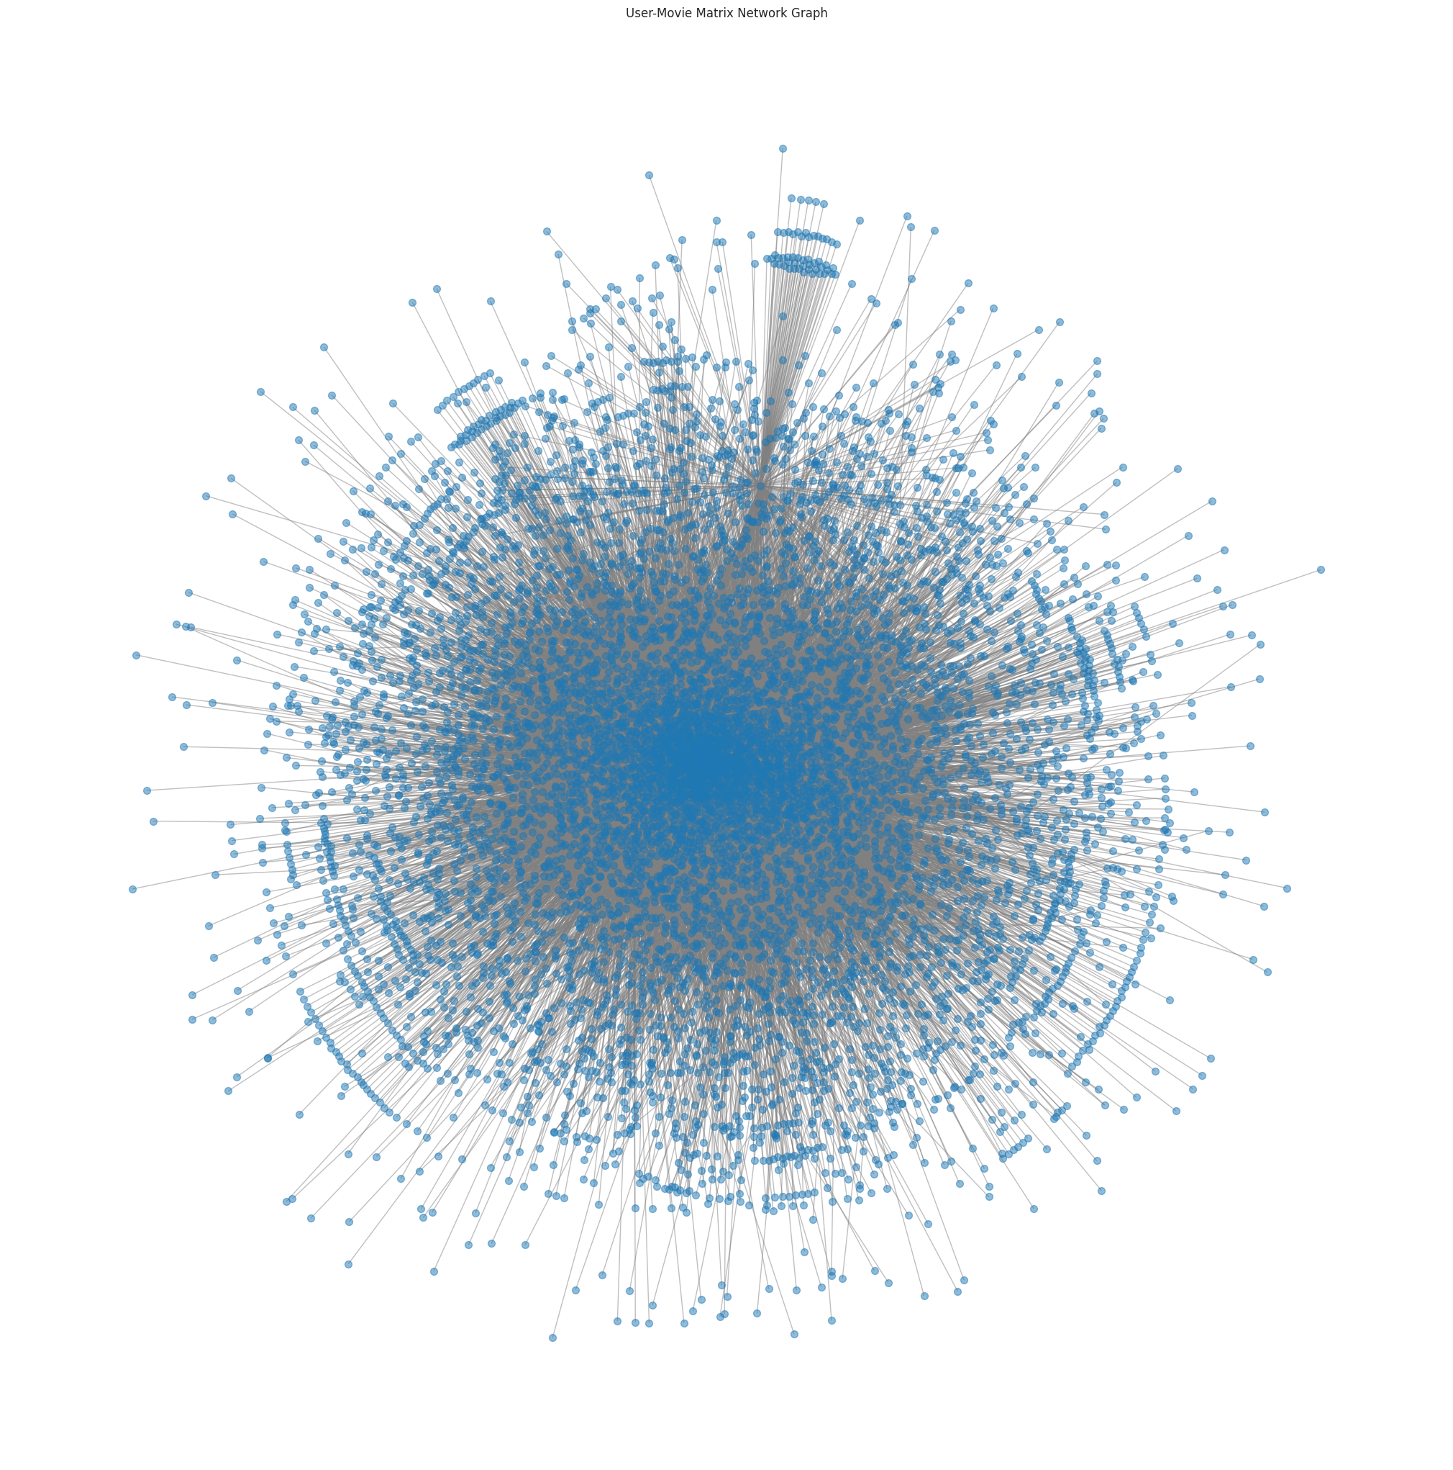
Relationship between Users and Movies

Slide 14
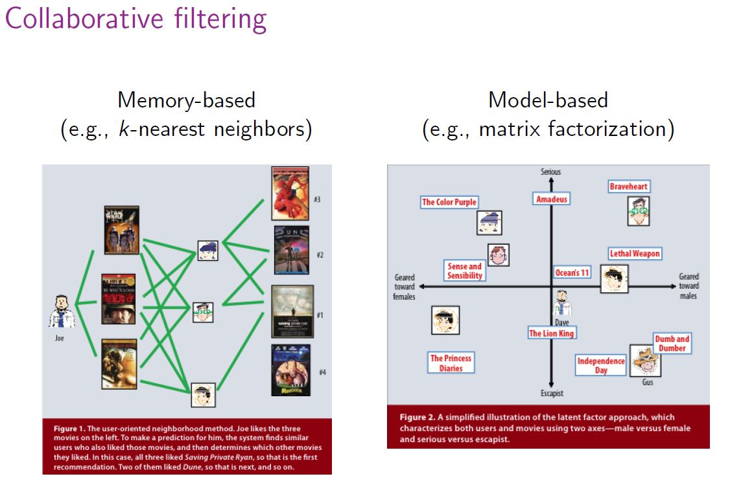
Categories of Collaborative Filtering
The class of collaborative filtering algorithms is divided into two sub-categories that are generally called memory based and model based approaches.
Memory based approaches directly works with values of recorded interactions, assuming no model, and are essentially based on nearest neighbours search (for example, find the closest users from a user of interest and suggest the most popular items among these neighbours).
Model based approaches assume an underlying “generative” model that explains the user-item interactions and try to discover it in order to make new predictions.

Slide 15

Memory Based Filtering - KNN
The implementation was based on the machine learning algorithm K-nearest neighbors, or KNN, to build a recommender system to predict movie ratings for users.
In order to make a new recommendation to a user, user-user method roughly tries to identify users with the most similar “interactions profile”. This method is said to be “User-centred”
To make a new recommendation to a user, the idea of item-item method is to find items similar to the ones the user already “positively” interacted with. This method is said to be “item-centred”
Memory based collaborative filtering do not scale easily: generating a new recommendation can be extremely time consuming for big systems. For systems with millions of users and millions of items, the nearest neighbours search step can become intractable if not carefully designed

Slide 16
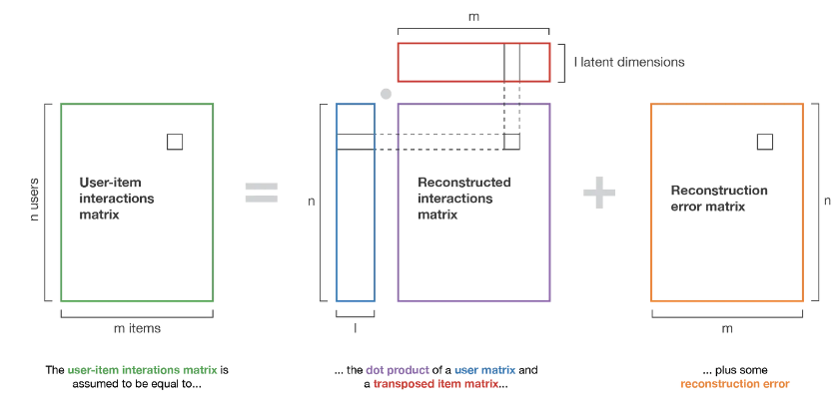
Model Based Filtering - Matrix Factorization
It is used to predict user preferences based on their past behavior. In this case, the matrix to be factorized represents user-item interactions, and the resulting factors represent user and item features. These features can then be used to generate personalized recommendations for users.
There are several methods for matrix factorization, including Singular Value Decomposition (SVD), Non-negative Matrix Factorization (NMF), CoClustering, SlopeOne. Each method has its own strengths and weaknesses.
For our case, We are using SVD.

Slide 17
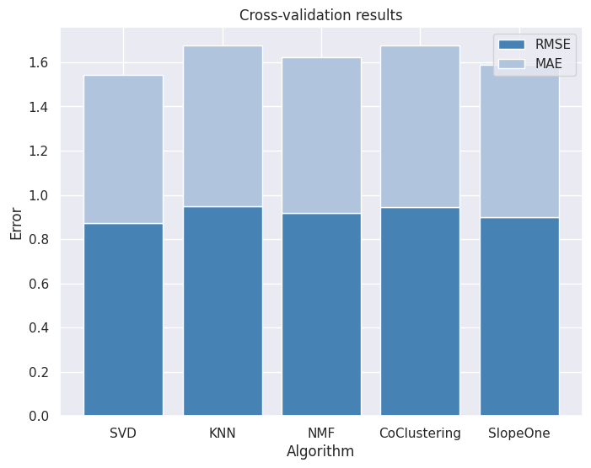
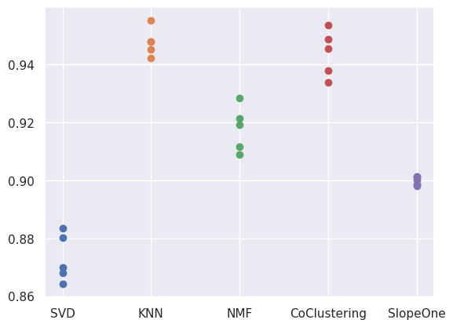
Comparing accuracy with RMSE

Slide 18
Rating Prediction
For the purpose of prediction of movie rating we are using KNN (Memory based) and Matrix Factorization method - SVD (Model based) to predict these ratings
We use the surprise module in Python to fit the training dataset to the SVD
Then we predict the scores for every movie a user hasn’t seen.
Model | Memory Based (KNN) | Model Based (SVD)
RMSE | 0.96 | 0.88
MAE | 0.74 | 0.67

Slide 19
Metrics
PRECISION
Precision = No of relevant recommendations/No of total recommendations
RECALL
Recall = No of relevant recommendations/ No of total relevant items.
F-Measure
F-measure = 2*Precision*Recall/(Precision+Recall)
Normalised Discounted Cumulative Gain (NDCG)
DCG = Σ((rel_i)/log (i+1)), and NDCG = DCG/IDCG

Slide 20
Results
Models | Precision | Recall | F-Score | NDCG
SVD | 0.68 | 0.41 | 0.51 | 0.81
KNN | 0.55 | 0.38 | 0.43 | 0.75

Slide 21
Advantages and Disadvantages
Advantages
User-Centric: It is based on the user's behavior and preferences, making it highly personalized and user-centric.
Scalable: Collaborative filtering is scalable to large datasets and can handle a large number of users and items. It can handle sparse data and can provide recommendations even for new or unpopular items.
No Domain Knowledge Required: Collaborative filtering does not require any domain knowledge or metadata about the items being recommended.
Disadvantages
Cold Start Problem: Collaborative filtering suffers from the cold start problem, which refers to the difficulty of providing recommendations for new users or items that do not have sufficient data.
Data Sparsity: Collaborative filtering requires a significant amount of user-item interaction data to provide accurate recommendations.

Slide 22
Future Work
Utilize more information from the dataset beyond just genres for personalized recommendations.
Use advanced recommendation techniques such as model-based and hybrid filtering
Avoid the "filter bubble" by recommending a balance of similar and diverse movies
Recommend movies based on recent events, understanding current trends, and recommending related movies.

Slide 23
Technical Methods for achieving privacy in Recommendation System
Differential privacy: Differential privacy is a mathematical framework for measuring the privacy of an algorithm or system. In the context of recommender systems, differential privacy can be used to add noise to user data or recommendation results, ensuring that individual user preferences cannot be inferred from the results.
Federated learning: Federated learning is a machine learning technique that enables multiple parties to collaborate on the training of a machine learning model without sharing their data directly. In the context of recommender systems, federated learning can be used to train a model using data from multiple users without requiring those users to share their data directly with the recommender system.
Bloom filter: Bloom filters can be used to anonymize user data by hashing the data and adding it to the Bloom filter. When making recommendations, the recommender system can query the Bloom filter to determine whether a particular item is in the user's set of preferences or not, without actually seeing the user's preferences directly.

Slide 24
Thank You.

